Slide 1
#thebestvirusgraphsteam
Alejandro Gener (lead)

Slide 3
Limitations of linear reference genomes
goal
reality

Slide 4
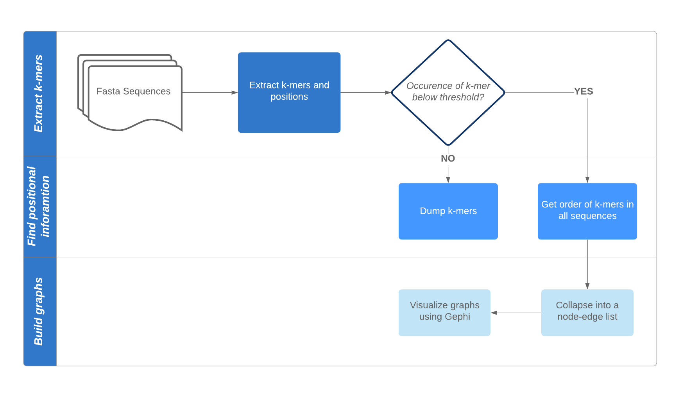
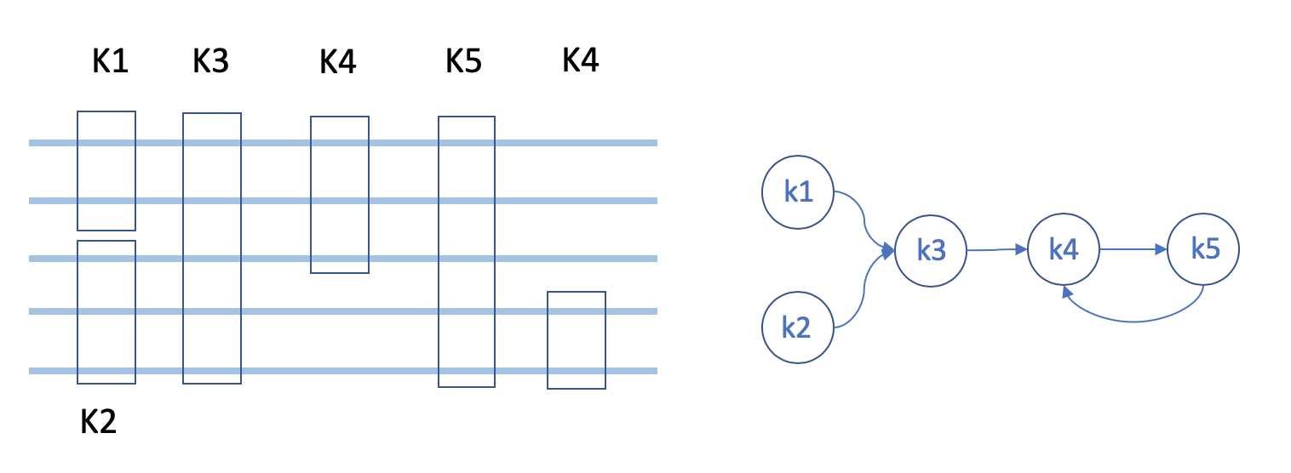
SWIGG: algorithm overview
https://github.com/NCBI-Codeathons/SWIGG; https://github.com/NCBI-Codeathons/Virus_Graphs

Slide 5
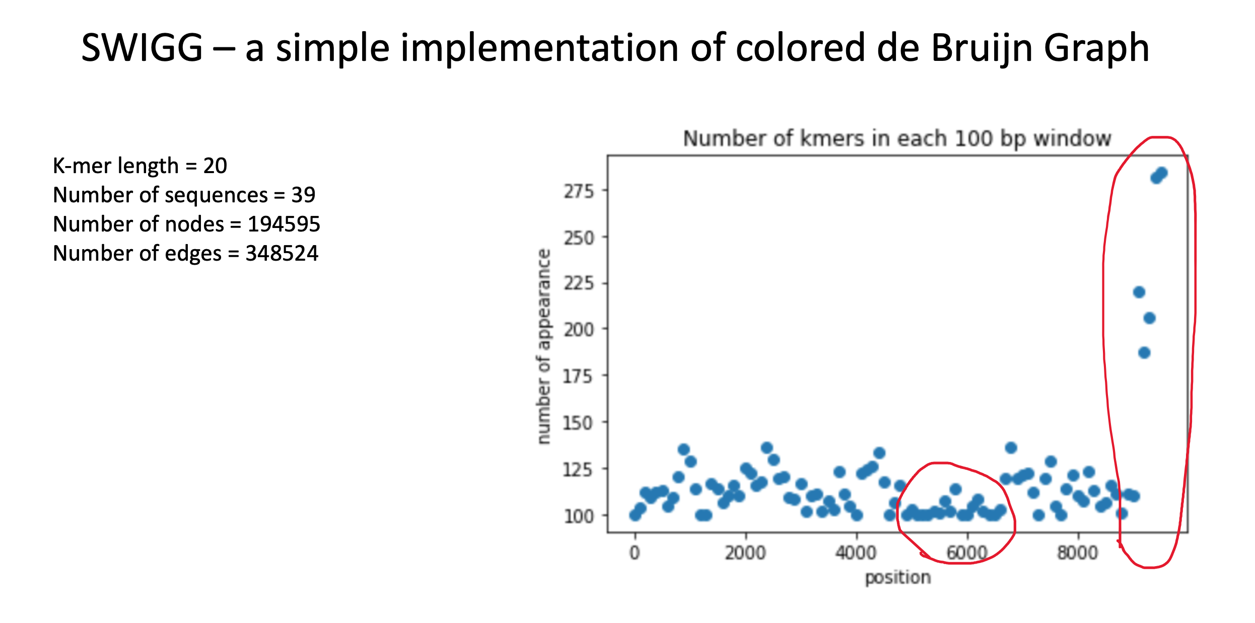
SWIGG - update

Slide 6
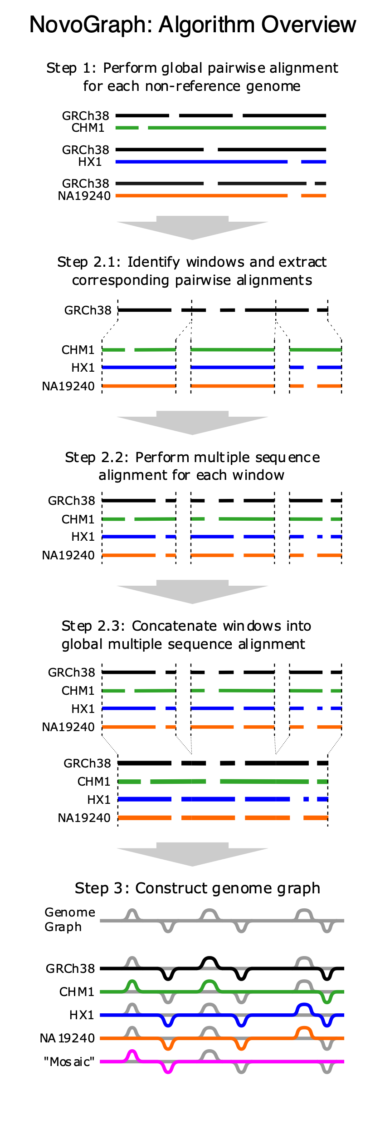
Novograph: algorithm overview
“MSA”
Modified from https://github.com/NCBI-Hackathons/NovoGraph

Slide 7
Novograph Issues
Split alignment didn’t work well with virus sequence
File formatting issues : convert dots in headers to underscores
BWA issues → convert mixed bases to Ns causing issues with steps downstream. To run with BWA had to convert mixed bases to Ns in input sequence
Minimap alignment supports mixed bases
MSA using Mafft ran successfully
Postprocess script for MSA requires PBS grid computing (qsub) support. Need to change the script to include SLURM (sbatch) support to run on PSC computing system

Slide 8
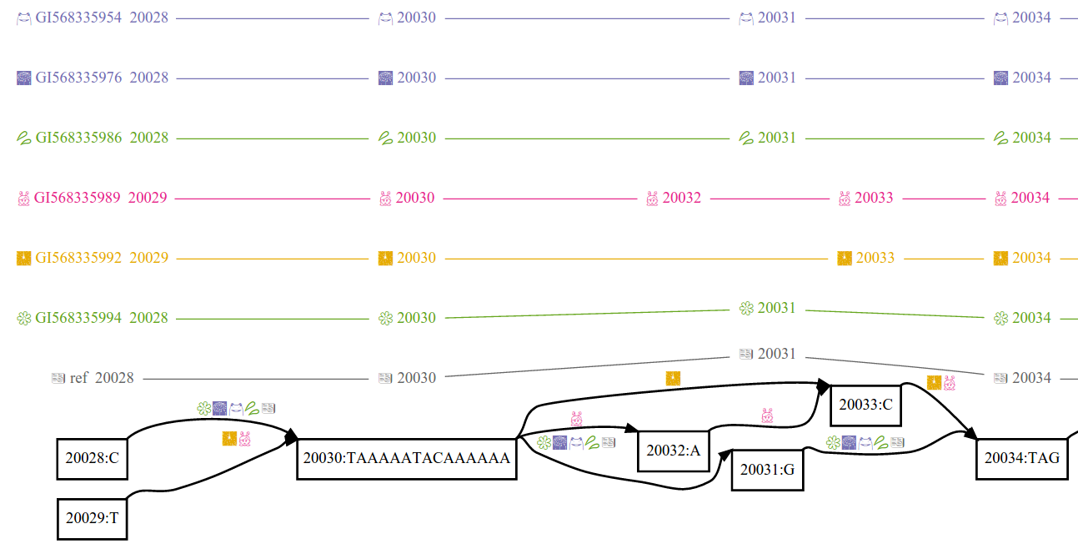
VG: algorithm overview
https://github.com/vgteam/vg

Slide 9
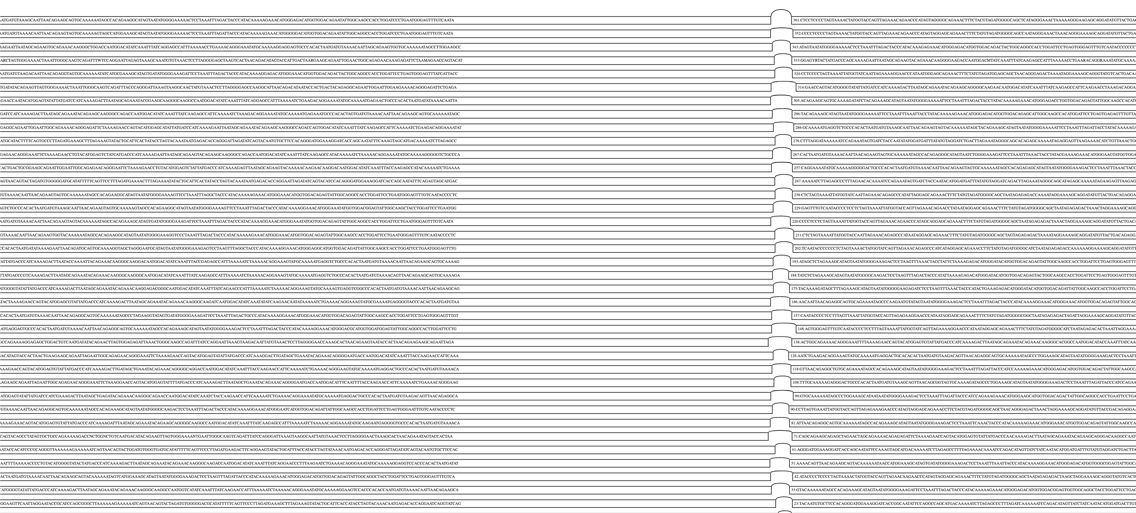
VG - update

Slide 10
HIV Linear reference(s)
SNV!
virus
provirus

Slide 11
HIV transcript model (beta)
cDNA-seq of HIV virion
Read mapping with HISAT2
Isoform prediction with StringTie
Implemented in usegalaxy.eu
TSS
Inactive polyA signal
Active polyA signal
unspliced
Spliced HIV mRNA
(many)
Singly spliced
Multiply spliced
*approximated by isoform level

Slide 12
HIV 101
HXB2 is subtype B
Notes:
Google: “hiv tree” https://en.wikipedia.org/wiki/Subtypes_of_HIV#/media/File:HIV-SIV-phylogenetic-tree_straight.svg
Hu, W.-S., & Hughes, S. H. (2012). HIV-1 Reverse Transcription. Cold Spring Harbor Perspectives in Medicine , 2(10). https://doi.org/10.1101/cshperspect.a006882

Slide 13
Kinds of Genome Graphs
Basepair-resolution
VG
Seven Bridges
Sparkle?
Approximate k-mer graphs

